Slide 1

Reflect on Own Safe Work Practices
HLTWHS002 - Follow safe work practices for direct client care (Release 2)

Slide 2



Reflection
is about looking back on how you performed your work role
will lead you to individual improvement
helps your organisation deliver safe services
enables you to identify how to maintain the safety of the workplace
is an important practice that you can use to take care of your psychological health.
Reflect on Own Safe Work Practices

Slide 3
In this chapter, you will learn how to:
identify ways to maintain currency of safe work practices
reflect on own levels of stress and fatigue
participate in workplace debriefing to address individual needs.
Reflect on Own Safe Work Practices

Slide 4

5.1
Identify Ways to Maintain Currency of Safe Work Practices

Slide 5
Maintaining currency involves continuous review and analysis of safe work practices.
You are looking at possible areas of improvement.
You will analyse practices based on guidelines, regulations, policies and procedures.
You must identify ways to maintain currency of safe work practices so that:
you remain compliant in your own practice
your organisation remains compliant with WHS laws
your clients receive the best care provisions.
Reflect on Own Safe Work Practices

Slide 6
Safe work practices may relate to:
workplace systems
workplace equipment
workplace processes.
Reflect on Own Safe Work Practices

Slide 7
5.1.1 Workplace Systems
A workplace system refers to the organisation’s approach to:
policies
procedures
the workplace environment.
A good workplace system has documented policies and procedures. This will ensure compliant and effective workplace practices.
Reflect on Own Safe Work Practices

Slide 8
Review and Updating of Policies and Procedures
WHS policies and procedures need to be reviewed on a regular basis.
Organisations need to check if these still meet legislative and industry requirements.
This will also help in identifying the needs and capabilities of workers.
Their effectiveness in achieving health and safety standards must also be examined.
Reflect on Own Safe Work Practices

Slide 9
Inspection of the Workplace Environment
Workplace inspections are regular examinations of the workplace.
These should be done on a regular schedule so that issues can be identified and addressed as quickly as possible.
Inspection of the work environment should involve both the physical and psychosocial aspects.
Reflect on Own Safe Work Practices

Slide 10
As a worker, you are the most aware of about what you need to perform your role effectively.
To maintain an adequate workplace environment, coordinate closely with your organisation.
You may meet with your colleagues to identify areas for improvement.
Together, you can bring concerns up to your supervisors.
Reflect on Own Safe Work Practices

Slide 11
Seeking Training on Workplace Systems
Every now and then, your workplace may introduce new systems.
This may be in the form of:
new policies and procedures
changes in the work environment
changes in processes and equipment.
Reflect on Own Safe Work Practices

Slide 12

5.1.2 Workplace Equipment
Your work role will require you to use different types of equipment regularly.
You may also need to use different equipment to track the health of your clients.
It is important to maintain your knowledge of practices involving workplace equipment.
Reflect on Own Safe Work Practices

Slide 13
You must always familiarise yourself with the latest equipment used in client care.
This will include knowing how to do the following:
Operate equipment safely
Maintain equipment so that they can be safely
Reflect on Own Safe Work Practices

Slide 14
Maintaining currency of safe work practices in relation to workplace equipment will involve the following:
Undergoing training on how to operate and maintain new equipment
Seeking supervision in operating new equipment
Accessing online and print resources about best practices related to new equipment
Reflect on Own Safe Work Practices

Slide 15
5.1.3 Workplace Processes
Workplace processes refer to how your organisation operates.
These include processes for:
performing client care tasks
risk management
emergency preparedness.
Reflect on Own Safe Work Practices

Slide 16
Performing Client Care Tasks
Participating in safety meetings is a good way for you to refresh your knowledge on performing tasks.
Other topics that may be discussed in safety meetings are:
responses to incidents or injuries
actions are taken to address hazards and risks.
Reflect on Own Safe Work Practices

Slide 17
Risk Management
Risk management is the process of identifying hazards and risks and taking measures to remove or minimise them.
The processes within risk management are:
hazard identification
risk assessment
risk control
review of effectiveness of control measures.
Reflect on Own Safe Work Practices

Slide 18
Hazards can be observed in:
the physical work environment
the equipment and materials used
the performance of work tasks
work design and management.
Reflect on Own Safe Work Practices

Slide 19
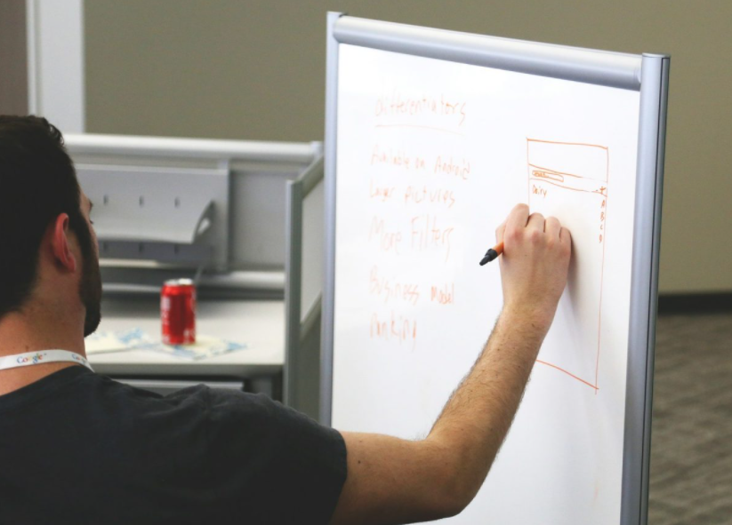
Regular assessments of the workplace should be observed so that:
existing hazards can be immediately addressed
potential hazards can be proactively dealt with.
Reflect on Own Safe Work Practices

Slide 20
Emergency Preparedness
Your organisation should have its own emergency plan that all workers should be familiar with.
Your organisation should also provide training in the form of:
regular fire and earthquake drills
first aid seminars
demonstration of an emergency shutdown of equipment.
Reflect on Own Safe Work Practices

Slide 21

5.2
Reflect on Own Levels of Stress and Fatigue

Slide 22
Stress and fatigue are known as psychosocial hazards, or hazards that may cause psychological or physical harm.
Health covers both psychological and physical aspects of your wellbeing.
Taking care of your mental and emotional state is just as important as ensuring your physical safety.
Reflect on Own Safe Work Practices

Slide 23

Stress
Stress is a state where you experience emotional or physical tension.
At work, you may experience stress when the demands of your work role exceed your capabilities as a worker.
Reflect on Own Safe Work Practices

Slide 24
Safe Work Australia identifies the following hazards that can lead to stress in the workplace:
Level of job demand
Unreasonable deadlines
Excessive workload
Highly repetitive tasks
Reflect on Own Safe Work Practices

Slide 25
Safe Work Australia identifies the following hazards that can lead to stress in the workplace:
Poor support
Workers do not have enough information or training to do their job.
Workers do not have access to employee assistance programs.
Reflect on Own Safe Work Practices

Slide 26
Safe Work Australia identifies the following hazards that can lead to stress in the workplace:
Poor workplace relationships
Discrimination
Harassment
Bullying
Reflect on Own Safe Work Practices

Slide 27
Safe Work Australia identifies the following hazards that can lead to stress in the workplace:
Poor role clarity
Poorly defined work roles
Conflicting job expectations
Reflect on Own Safe Work Practices

Slide 28
Safe Work Australia identifies the following hazards that can lead to stress in the workplace:
Poor organisational change management
Changes to the organisation are poorly managed.
Changes to the organisation are not communicated to workers.
Reflect on Own Safe Work Practices

Slide 29
Safe Work Australia identifies the following hazards that can lead to stress in the workplace:
Poor organisational justice (how a worker judges their organisation’s behaviour in terms of fairness)
Inconsistency or bias in the implementation of procedures
Poor environmental conditions
Exposure to extreme weather conditions
High noise levels
Reflect on Own Safe Work Practices

Slide 30
Safe Work Australia identifies the following hazards that can lead to stress in the workplace:
Remote or isolated work
Worker is not provided with a method of communication in case of emergencies.
Violent or traumatic events
No access to counselling or therapy
Lack of support from co-workers and supervisors
Reflect on Own Safe Work Practices

Slide 31

The symptoms of stress may fall under four types:
Behavioural
Emotional
Physical
Cognitive
Reflect on Own Safe Work Practices

Slide 32
Fatigue
Fatigue is a physical state characterised by a lack of energy.
When you are fatigued, it affects the way you work.
It may slow down your pace of work or cause you to lose focus altogether.
Reflect on Own Safe Work Practices

Slide 33
Causes of fatigue include:
prolonged or intense mental or physical activity
sleep loss and/or disruption of your internal body clock
organisational change
travel
exceptionally hot or cold working environments
Reflect on Own Safe Work Practices

Slide 34
Causes of fatigue include:
work scheduling
excessively long shifts
not enough time to recover between shifts
strenuous jobs
long commuting times.
Reflect on Own Safe Work Practices

Slide 35
Signs of fatigue include:
tiredness even after sleep
reduced hand-eye coordination or slow reflexes
short term memory problems and an inability to concentrate
blurred vision or impaired visual perception
a need for extended sleep during days off work.
Reflect on Own Safe Work Practices

Slide 36

Reflecting on Levels of Stress and Fatigue
You can adapt the risk management process and use it as a self-reflection tool to identify and assess your emotional and mental wellbeing.
Reflect on Own Safe Work Practices

Slide 37
Procedure for Reporting Psychosocial Health
You have the following obligations under the WHS Act:
Take reasonable care of your own health and safety.
Take reasonable care that your actions or omissions do not affect the health and safety of other persons.
Reflect on Own Safe Work Practices

Slide 38
After reflecting on your stress and fatigue levels, you must report your reflection to designated persons.
Since your health condition affects your work performance, you must report any problems caused by stress and fatigue.
The designated person may be your supervisor or a human resources (HR) officer in your organisation.
Reflect on Own Safe Work Practices

Slide 39
In the table below, you can see the responsibilities of these designated persons in helping you address stress and fatigue.
Designated persons | Responsibilities
Supervisor | Assigning work tasks and managing workloads Monitoring your progress and issues in accomplishing work tasks
Reflect on Own Safe Work Practices

Slide 40
In the table below, you can see the responsibilities of these designated persons in helping you address stress and fatigue.
Designated persons | Responsibilities
Supervisor | Maintaining your health and welfare while at the workplace Providing resources that will help you minimise stress and fatigue at work
Reflect on Own Safe Work Practices

Slide 41
In the table below, you can see the responsibilities of these designated persons in helping you address stress and fatigue.
Designated persons | Responsibilities
Human resources officer | Monitoring each employee’s work performance Reporting on aspects that positively and negatively affect work performance Providing programs and initiatives to promote employee welfare, health and safety
Reflect on Own Safe Work Practices

Slide 42
In the table below, you can see the responsibilities of these designated persons in helping you address stress and fatigue.
Designated persons | Responsibilities
Human resources officer | Recommending and organising counselling or psychological support for employees Reviewing work conditions that may affect the stress and fatigue levels of employees
Reflect on Own Safe Work Practices

Slide 43
Your supervisor can help you address concerns related to your work responsibilities.
An HR officer can manage your overall concerns regarding your workplace or organisation.
This may include:
how you relate to other employees
how you are affected by certain workplace processes.
Reflect on Own Safe Work Practices

Slide 44
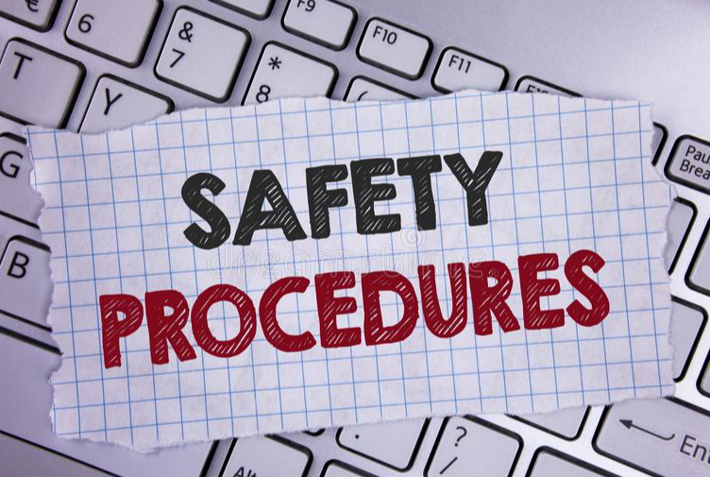
You must follow workplace procedures when reporting about your stress and fatigue levels.
It is important to let your organisation know about your stress and fatigue levels.
Reflect on Own Safe Work Practices

Slide 45
Following workplace procedures for reporting will ensure that:
designated persons fully understand your concerns
your concerns are given due attention
your concerns are properly recorded and documented
designated persons can help you come up with solutions to address your concerns.
Reflect on Own Safe Work Practices

Slide 46
Workplace procedures for reporting stress and fatigue levels may provide guidance on:
who to talk to about stress and fatigue and how to approach them
what to discuss during meetings and consultations about stress and fatigue
what information to provide to designated persons about your stress and fatigue levels
how to document reports regarding your stress and fatigue levels.
Reflect on Own Safe Work Practices

Slide 47

You may follow these steps in reporting about your stress and fatigue levels:
Schedule a meeting with the designated person.
Talk about your own reflection.
Seek the designated person’s advice.
Reflect on Own Safe Work Practices

Slide 48
When you experience high stress and fatigue, it is important to let these designated persons know about it.
If no action is taken, you may risk long term health effects.
Stressed and fatigued workers will tend to be less productive and may make more mistakes on the job.
Everyone in the organisation must work together to ensure a healthy working environment.
Reflect on Own Safe Work Practices

Slide 49

5.3
Participate in Workplace Debriefing to Address Individual Needs

Slide 50
Workplace debriefing involves supporting employees who experience critical incidents at work.
This is necessary in client care since you may undergo traumatic experiences such as critical injuries or, in the worst case, the death of a client.
Workplace debriefing aims to:
help employees share and reflect on their thoughts and emotions
guide employees in recovering from the incident.
Reflect on Own Safe Work Practices

Slide 51
Workplace debriefing will help you resolve any needs and issues that may arise from incidents.
This is also the opportunity for you to receive the support that you need so that your future work endeavours are not sacrificed.
Take note that debriefing is a voluntary activity.
It aims to provide support for employees with specific needs following incidents in the workplace.
Reflect on Own Safe Work Practices

Slide 52
Debriefing activities may possibly include sharing of sensitive information.
It will also involve identifying key needs of workers in relation to certain work incidents.
The following personnel may conduct debriefings:
Trained debriefer
Work supervisor/
manager
Human resources officer
Occupational health and safety officer
Doctor
Psychologist/
Psychiatrist
Reflect on Own Safe Work Practices

Slide 53
To participate in a workplace debriefing, you must first express your need for the debriefing.
After critical incidents, your organisation may organise debriefing sessions for workers involved.
If you are involved in an incident, you may sign up for the debriefing.
Reflect on Own Safe Work Practices

Slide 54
Alternatively, you may also discuss your need for debriefing with your supervisor.
This applies to cases wherein the organisation does not schedule a debriefing following an incident.
Approach your supervisor and talk about scheduling a debriefing.
Explain to them why you need a debriefing.
Reflect on Own Safe Work Practices

Slide 55

After setting a schedule, you must attend the debriefing and participate in discussions.
Workplace debriefings are incident specific. It follows from a critical incident experienced by workers in the workplace.
Reflect on Own Safe Work Practices

Slide 56
During the debriefing, you may discuss:
the manner and sequence in which events took place
people affected by the incident
factors that caused the incident
consequences of the incident
individual experience of people involved
how each person felt about the incident
action plans on how to support the people affected by the incident.
Reflect on Own Safe Work Practices

Slide 57
Action plans are very important.
There must be a resolution on how to support workers following an incident.
Otherwise, workers may not be mentally prepared to return to work.
The incident may continue to negatively affect their work performance.
Reflect on Own Safe Work Practices

Slide 58
It is also important to note that issues may not always be resolved after one debriefing session.
In most cases, follow-up support is required to check in on workers.
Support after incidents may come in the form of:
additional counselling
review of practices and resources
training and development activities
additional supervision and guidance.
Reflect on Own Safe Work Practices

Slide 59

What have we learned?
In this part of the session, we have covered:
Follow safe work practices for direct client care
Follow safe work practices for manual handling
Follow safe work practices for infection control
Contribute to safe work practices in the workplace
Reflect on own safe work practices

Slide 60
End of Chapter 5

Slide 61

Presentation Objectives
Now that you have completed this presentation, you should be able to:
Follow safe work practices for direct client care
Follow safe work practices for manual handling
Follow safe work practices for infection control
Contribute to safe work practices in the workplace
Reflect on own safe work practices

Slide 62
End of HLTWHS002 Presentation

Slide 63
Version Control & Document History
Date | Summary of Modifications | Version
11 April 2022 | Version 1.0 released for publishing | 1.0
25 May 2023 | Version 1.1 endorsed for use Modified some discussions in Section 3.1.1 | 1.1

